Slide 1

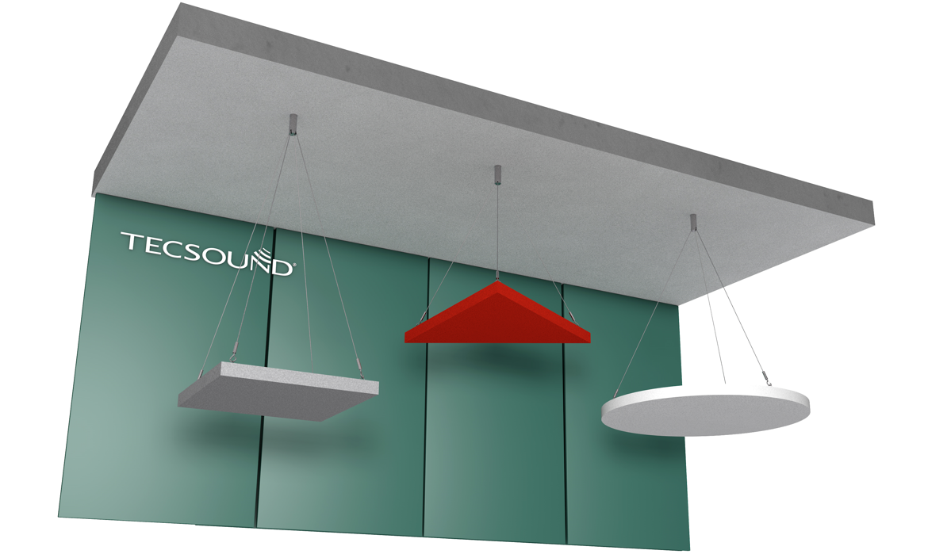
Recommendations for positioning fasteners on Pure Kustik Islands

Slide 2
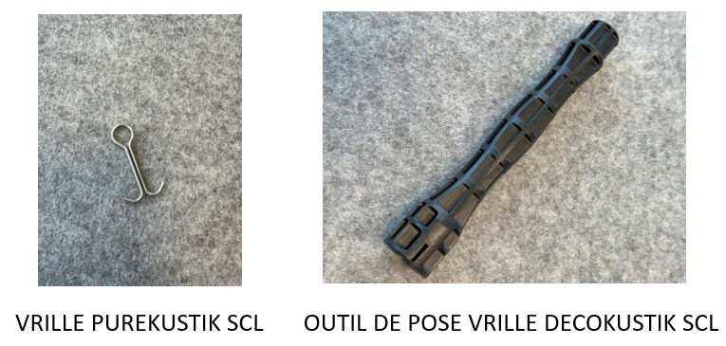
Fasteners on Pure Kustik Islands
PURE KUSTIK FASTENER SCL
INSTALLATION TOOL DECOKUSTIK FASTENER SLC

Slide 3
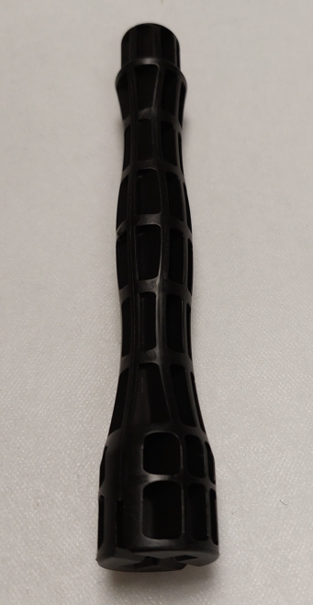
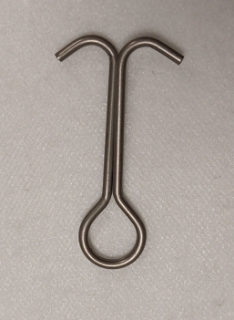
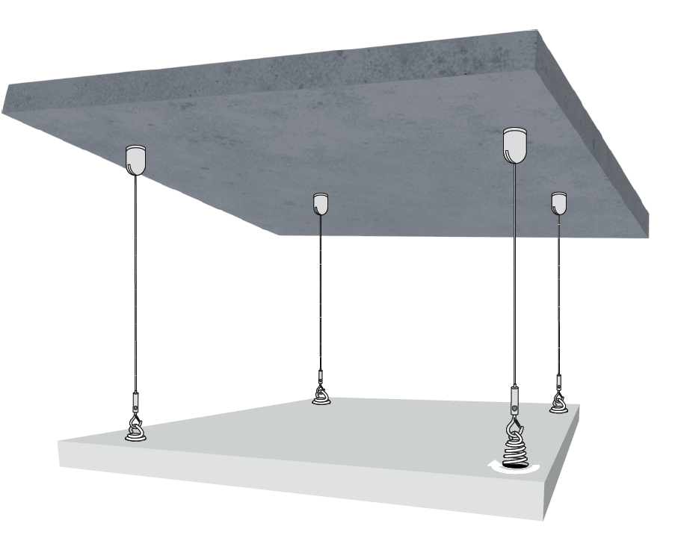
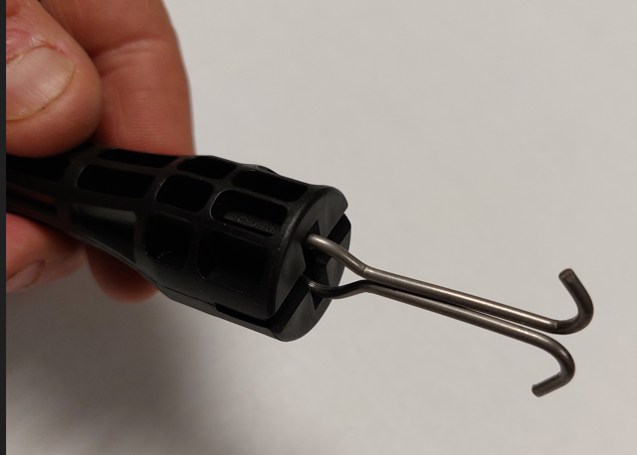
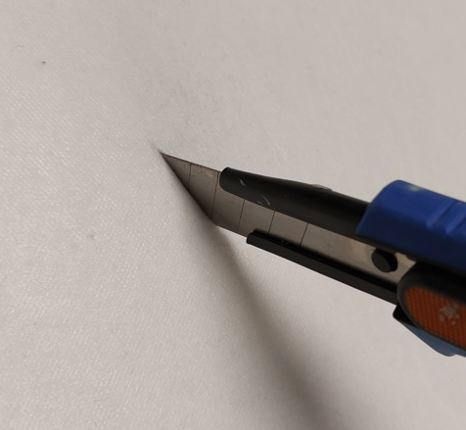
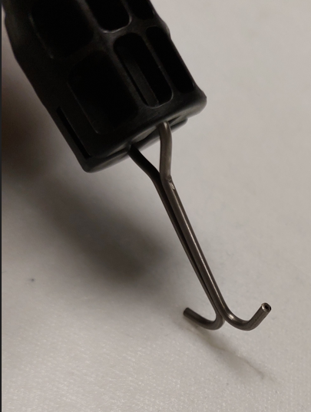
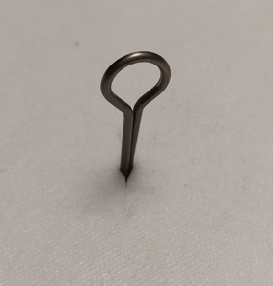
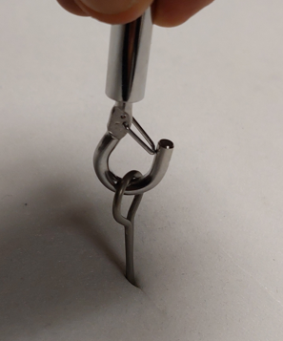
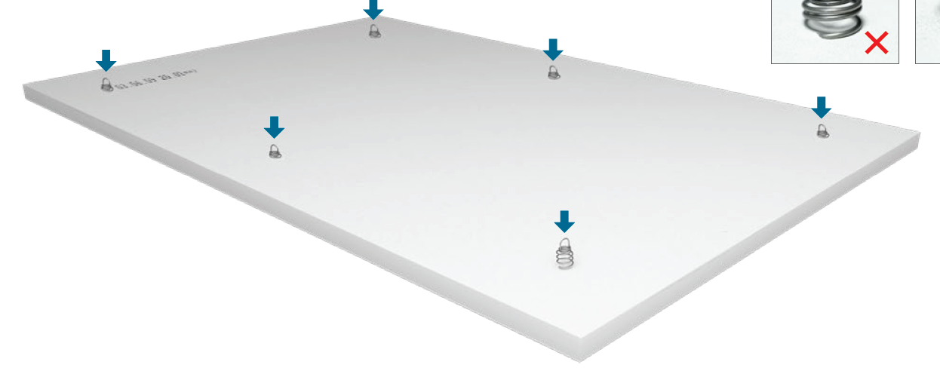
Positionning of fasteners
1
2
3
4
6
6
7
Quater turn

Slide 4
Positionning of fasteners
Scale: 1/10
1000 x 1000 mm
800 x 800 mm
600 x 600 mm
200 mm
200 mm
3
3
100 mm
200 mm
1
1
3
3
100 mm
200 mm
1
1
3
3
3
3

Slide 5
Positionning of fasteners
Scale: 1/10
1200 x 1200 mm
300 mm
1200 x 600 mm
4
4
100 mm
300 mm
2
2
300 mm
2
2
4
4

Slide 6
Positionning of fasteners
Scale: 1/10
1600 x 1200 mm
300 mm
4
6
500 mm
4
300 mm
4
6
4

Slide 7
Positionning of fasteners
Scale: 1/10
2000 x 1200 mm
300 mm
5
600 mm
7
600 mm
5
400 mm
5
5

Slide 8
Positionning of fasteners
Scale: 1/10
2400 x 1200 mm
300 mm
4
600 mm
7
600 mm
7
600 mm
4
300 mm
4
7
7
4

Slide 9
Positionning of fasteners
Scale: 1/10
Diam 1000 mm
Diam 800 mm
Diam 600 mm
200 mm
150 mm
100 mm

Slide 10
Positionning of fasteners
Scale: 1/10
Diam 1200 mm
200 mm

